Slide 1
Segment Tree Algorithm

Slide 2
Project Team
Mohamed Saeed El-Naggar
Mohamed Refat Byoumi
Mohamed Hassan Imam
Mohamed Bahaa ElDin
Mohamed Khaled Mohamed
Mohamed Ebrahem Fatoh

Slide 3
Problem Definition
Let’s Define an Array of integers ,
Now if we Want to Know to Ask what is the Maximum Value inRange [l , r]
or if we want to know what is the Minimum Value in Range [l , r] or something like SumValue in range[l , r] .
If We implement Naïve Algorithm That will take a large Time.
And if we want to update the Array and Check again and again So that’s Will Take
a Large Time !
From here Segment Tree Algorithm came to Solve this Problem

Slide 4

Naïve Algorithm
Ques1 .Find Sum Value in range [ 2 , 8 ] ?
→ Answer 33
Ques1 .update the 3rd Position to be = 13
and Find Sum Value in range [ 2 , 8 ] ?
→ Answer 44

Slide 5
Naïve Algorithm. PesudoCode
Sum→ 0
for i → L to R :
Sum ← Sum + Arr[i]
// Sum Contain the Sum Value in range (l , r)

Slide 6
Naïve Algorithm
Time Complexity →
For Search → O ( n )
For Update → O ( n )
So this is Very Large and Take time to get The Value or update Element in the Array

Slide 7
Let’s Try our Fastest Algorithm

Slide 8
Segment Tree Algorithm

Slide 9
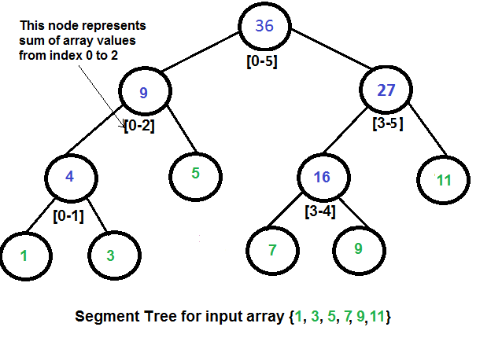
Figure 1

Slide 10

Let’s Browse Segment Tree Algo’s Function

Slide 11
Assistance Function
int getLeft(int i){ return (i << 1) ; } // get LeftChild in The Tree
int getRight(int i){return (i << 1) + 1 ;} // get Right child in the Tree

Slide 12
Built Tree Function
void BuiltTree(int l , int r , int p = 1){
if(l == r) NewA[p] = A[l] ;
else {
int mid = l + (r - l) / 2 ; // get Mid Position
BuiltTree(l , mid , getLeft(p)) ; // go to LeftChild
BuiltTree(mid + 1 , r , getRight(p)) ; // go to RightChild
NewA[p] = NewA[getLeft(p)] + NewA[getRight(p)]; // Backtracking
/*
* Put Sum of LeftChild and RightChild into Parent (P)
* if A : [ 2 3 4 5 ]
*
* 14
* / \
* / \
* 5 9
* / \ / \
* 2 3 4 5
*/
}
}

Slide 13
Update Tree Function
void UpdateTree(int l , int r , int i , int j , int val , int p = 1){ // Update Range(i , j)
// Out of Range
if(i > r || l > j) return ;
if(l == r){
NewA[p] += val ; // Update With Val
return ; // There is No More Childs to Visit
}
int mid = l + (r - l) / 2 ; // get Mid Position
UpdateTree(l , mid , i , j , val , getLeft(p)) ; // goto LeftChild
UpdateTree(mid + 1 , r , i , j , val , getRight(p)) ; // goto RightChild
NewA[p] = NewA[getLeft(p)] + NewA[getRight(p)] ; // Backtracking
/*
* Update Value of Parent After Updating Left and Right Child
*/
}

Slide 14
Range Min Query Function
int RangeSumQuery(int l , int r , int i , int j , int p = 1){ // get Sum for Range(i , j)
// Out of Range
if(i > r || l > j) return 0 ; // Value to indicator that is not in My Sum Range
if(l >= i && j >= r) return NewA[p] ; // This is Exactly My Range
// Else i Will Browse Left and Right Child
int mid = l + (r - l) / 2 ; // get Mid ;
int FirstPart = RangeSumQuery(l , mid , i , j , getLeft(p)) ; // goto Left Child
int SecondPart = RangeSumQuery(mid + 1 , r , i , j , getRight(p)) ; // goto Right
return FirstPart + SecondPart ; // Return Sum Val of All My Range
}

Slide 15
Complexity
Built Function : O ( n log n )
Update Function : O ( n )
RMQ Function : O ( log n )

Slide 16
More Optimization
Using
Lazy Propagation

Slide 17
Update Function
Complexity → log ( n )
if(Lazy[p]){
NewA[p] += Lazy[p] ;
if(l != r){ // Child are Not Update With New Val
Lazy[getLeft(p)] += Lazy[p] ; // Update Left
Lazy[getRight(p)] += Lazy[p]; // Update Right
}
Lazy[p] = 0 ; // This Range Was already Updated -->
}

Slide 18
Thanks. ^_^

